Slide 1
Stock

Slide 2
Stock is a liquid containing the juices of meat, bones or vegetables that have been extracted by long, slow cooking. Stocks are the foundation for many soup recipes, and are a wonderful way to use leftover meats and vegetables.
Flavor, body and clarity are the characteristics of a good stock.
Cooking times for stocks varies.

Slide 3
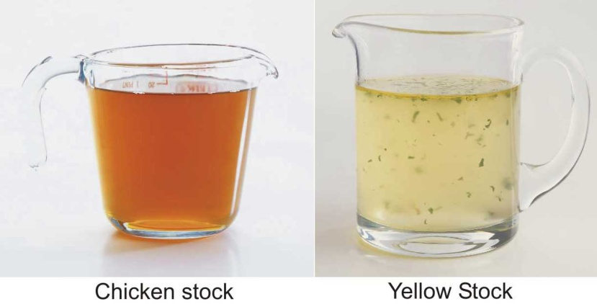
Contd…..
A stock is a flavorful liquid made by gently simmering bones or vegetables in a liquid to extract their flavor, aroma, color, body, and nutritive value. When bones, vegetables, flavorings, and aromatic ingredients are combined in the proper ratio and simmered for an adequate amount of time, the stock develops a characteristic that is peculiar to a stock type.

Slide 4
Components of Stock
Bones - Bone, Veal, beef, and chicken bones are most commonly used.
Vegetables - Vegetables for a vegetable stock or court bouillon should be prepared according to type. Mushrooms should be trimmed and wiped to remove dirt.
Liquid - Water is the most frequently used liquid for making stock.

Slide 5
Contd…..
Mirepoix - It is a combination of onions, carrots, celery, and sometimes other vegetables.
Herbs and spices - The herbs and spices used depend on availability and local traditions. In classical cuisine, the use of a bouquet garni (or bundle of herbs) consisting of parsley, bay leaves, a sprig of thyme and possibly other herbs, is common. This is often wrapped in a cheesecloth "bag" and tied with string to make it easier to remove it once the stock is cooked.

Slide 6
TYPES OF STOCKS
White Stock
It is made from the meaty bones and trim from veal, beef, poultry, some types of game, and fish. The bones are frequently blanched in order to remove any impurities that might cloud or discolor the finished stock.
Brown Stock
Brown Stock is one of the most commonly called-for stocks in the classic and contemporary repertoire of any kitchen is likely to be brown veal stock (fond de veau brun). Brown stocks are prepared by first cooking meaty bones and meat trim to a deep brown color, as well as the mirepoix and a tomato product, before they are simmered. This changes both the flavor and color of the finished stock

Slide 7
Contd…..
Broth (or Bouillon)
Broth shares many similarities with stocks. They are prepared in essentially the same fashion. Meaty bones (or in some cases, the entire cut of meat, bird or fish) are simmered in water along with a variety of vegetables and other aromatic ingredients. Many meatless dishes are prepared with a vegetable broth.
Fumet (or Essence)
The most common fumet is one prepared by sweating fish
bones along with vegetables such as leeks, mushrooms and celery, then simmering these ingredients in water, perhaps with the addition of a dry white wine. The end result is generally not as clear as a stock, but it is highly flavored. Fumets and essences can be prepared from such ingredients as wild mushrooms, tomato, celery
or celery root, ginger and so forth.

Slide 8
Contd…..
Chicken Stock
Chicken stock should be cooked for 4–5 hours. Veal stock should be cooked anywhere from 8 hours to overnight.
Fish Stock
Fish stock is made with fish bones and finely chopped mirepoix. Fish stock should be cooked for 30–45 minutes—cooking any longer spoils the flavour.

Slide 9
USES OF STOCK
as base for sauces and soups
as base for stews and braises
as a cooking medium for vegetables and grains

Slide 10
BASIC PREPARATION METHOD
Combine the major flavoring ingredients with cold liquids and bring to a simmer. The stock will throw scum to the surface as it begins to cook. This should be skimmed away as necessary throughout the simmering time to develop a clear stock with good flavor.
Add the mirepoix and aromatics at the appropriate point.
Simmer for appropriate time, for developing a good flavor, aroma, color, and body.

Slide 11
Contd…..
Drain the stock through a sieve or colander into an appropriate container for cooling.
Cool the stock
Store the stock in containers that are easy to handle to avoid injury from weight. Remove any fat from the surface after the stock has cooled.

