Slide 1
Define the term ‘Catering’
A catering establishment is defined as one that provides food and or drink (beverage).
This is known as a product-and-service provider.
Lots of different kinds of commercial (for money) businesses operate in the catering industry, but there are also non-commercial businesses in the industry.

Slide 2
Types of Establishments - Catering (Hospitality will be looked at in more detail later in the course)
There are 3 main categories into which a type of establishment can fall.
Residential establishments
Non-residential establishments
Non-commercial residential establishments
How many can you think of? - Complete your brainstorm

Slide 3
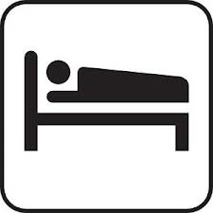
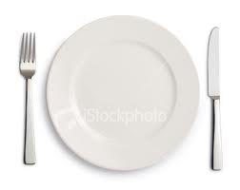
Types of Catering Establishments
Residential
Non- Residential
Non-Commercial Residential
Contract Caterers - Caterers who provide food & drink for a function where catering facilites are not already provided.
They prepare the food for functions such as weddings, banquets, garden parties & parties in private houses. They may prepare & cook the food in advance & deliver it to the venue, or they may cook it on site. They may also provide staff to serve the food if required. Contract caterers are used by a wide range of organisations as it relieves them of the pressures involved in catering for such events.

Slide 4
Lists of types of Catering Establishments
Residential
Hotels
Guest Houses
Holiday Parks
Farmhouses
Public Houses
Bed and Breakfasts
Non -Residential
Restaurants
Cafes
Fast-food outlets
Public houses
Wine bars
Delicatessen & Salad Bars
Take-away outlets
School meals & transport catering
Burger vans
Non-Commercial residential Establishments
Hospitals
Residential homes
Prisons
Armed Services
Task - Make sure you have included all of these in your brainstorm.
Now add some names of businesses that you know of next to each type of establishment. E.g Fast-food outlets – Mc Donalds.

Slide 5
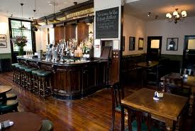
Public House & Wine Bar
A pub, formally public house, is a drinking establishment fundamental to the culture of Britain. In many places, especially in villages, a pub can be the focal point of the community. The writings of Samuel Peppys describe the pub as the heart of England.
Pubs would sell a range of beers, wines, spirits, and soft drinks. Recently there has been a growth in pubs selling meals and some now call themselves ‘Gastro Pubs’. Many pubs are controlled by breweries (companies who make alcoholic drinks).
The owner, tenant or manager (licensee) of a pub is properly known as the "pub landlord". The term has come into use since Victorian times to designate the pub landlord. Known as "locals" to regulars, pubs are typically chosen for their proximity to work, the availability of a particular beer, hosting a darts team, having a pool table, or appealing to friends.
Wine bar (also known as a bodega) is similar to a pub but has more of a focus on selling wine, than liquor or beer. A typical feature of many wine bars is a wide selection of wines available by the glass. Wine bars also tend to have a more ‘up-market’ /m modern interior than a pub.

Slide 6
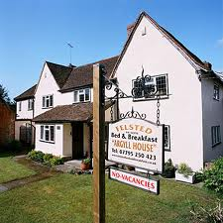
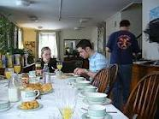
Bed & Breakfast
A bed and breakfast (or B&B) is a small lodging establishment that offers overnight accommodation and breakfast, but usually does not offer other meals. Typically, bed and breakfasts are private homes with fewer than 10 bedrooms available for commercial use.
The owners will live at the B&B and generally run it themselves, sometimes employing a cook and a cleaner.

Slide 7
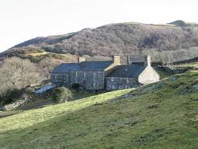
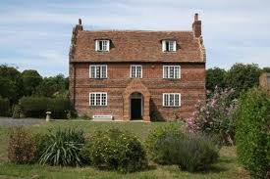
Farmhouse
Farmhouse is a general term for the main house of a farm. It is a type of building or house which serves a residential purpose in a rural or agricultural setting. Most often, the surrounding environment will be a farm.
Farmhouses may provide similar accommodations to a B&B and a Guesthouse

Slide 8
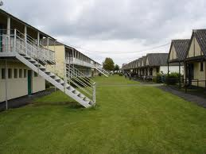
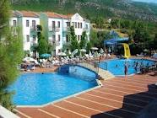
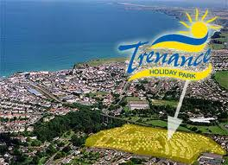
Holiday Park
A Holiday Park / camp , is a type of holiday accommodation that encourages holiday-makers to stay within the site boundary and provides entertainment for them between meals. They are sometimes known as Resort or Holiday village.

Slide 9
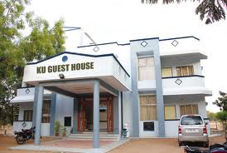
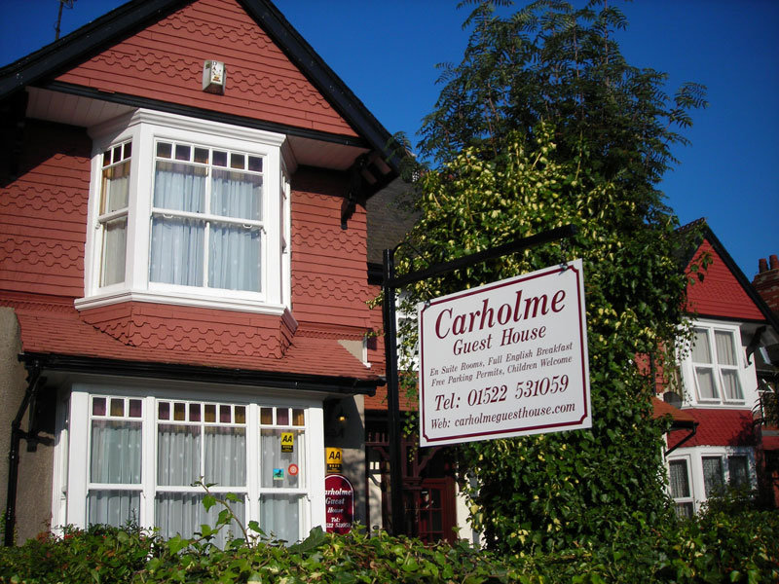
Guest House
A guest house is a kind of lodging. In some parts of the world a guest house is similar to a hostel, bed and breakfast or whereas in other parts of the world, guest houses are a type of inexpensive hotel-like lodging. In still others, it is a private home which has been converted for the exclusive use of guest accommodation. The owner usually lives in an entirely separate area within the property and the guest house may serve as a form of lodging business.
. Among the features which distinguish a guest house from a hotel, bed and breakfast, or inn is the lack of a full-time staff.
Bed and breakfasts are usually family-owned, with the family living on the premises. Hotels maintain a staff presence 24 hours a day and 7 days a week, whereas a guest house has a more limited staff presence. Because of limited staff presence, check in at a guest house is often by appointment. An Inn also usually has a restaurant attached.

Slide 10
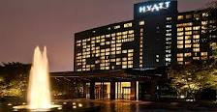
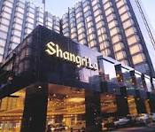
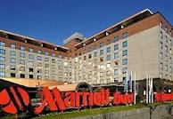
Hotels
A hotel is an establishment that provides lodging paid on a short-term basis. The facilities provided depend on the quality of the hotel. Common things found in a hotel bedrooms could include en-suite bathrooms and air conditioning., a telephone, an alarm clock, a television, a safe, a mini-bar with snack foods and drinks, and facilities for making tea and coffee, bathrobes and slippers. Hotel rooms are usually numbered to allow guests to identify their room.
Larger hotels may provide additional guest facilities such as a swimming pool, fitness center, business center, childcare, conference facilities and social function services
Some hotels offer meals as part of a room and board arrangement. In the United Kingdom, a hotel is required by law to serve food and drinks to all guests within certain stated hours.

